Slide 1
Verbal and Non-verbal Communication
Kinesics
Proxemics
Chronemics

Slide 2
Kinesics
This is the body language
Body also communicates through various movements
Takes place largely in the subconscious
To keep an open & positive demeanor.
Body language is imperative

Slide 3
Personal Appearance
Pleasing to the eyes of the audience
Should be clean and well groomed
The speaker communicates through a sober and neat appearance
Notes:
The presenter must be pleasing to the eyes of the audience. One should be clean and well groomed conforming to the need of the occasion. Appearance is also the part of the message that one wants to communicate. The speaker communicates through a sober and neat appearance how he feels about himself and how he wants the audience to view him.

Slide 4
Posture
Posture refers to one’s standing, sitting or walking
posture conveys to a great deal
Refer to the way we hold ourselves
Relaxed way is a positive posture
Neither remain static nor fidget
Notes:
It refer to the way we hold ourselves when we stand, sit or walk. Standing, sitting or walking in a relaxed way is a positive posture. Neither remain static nor fidget. The way you sit, stand or walk reveals a lot about you. A slumped posture shows low spirits. Erect and leaning forward shows low spirits, openness and honesty. Leaning back and closed arms show defensive attitude.
When an actor initially learns a new character part, he or she will instinctively adopt a distinct posture or stance to convey that character. It follows therefore that while you are on stage, your stance and posture will convey a great deal about you. The least you must do is make sure your stance does not convey boredom; at best, you can use your whole body as a dynamic tool to reinforce your rapport with the audience.
The perennial problem is what to do with your hands. These must not wave aimlessly through the air, or fiddle constantly with a pen, or (worst of all visually) juggle change in your trouser pockets. The key is to keep your hands still, except when used in unison with your speech. To train them initially, find a safe resting place which is comfortable for you, and aim to return them there when any gesture is completed.
Move occasionally and increase emphasis to hold attention of the audiences. The way he speaks, sits, stands, or walks, reveals a lot about him. Too much fidgeting with ones documents standing rigidly immobilized and nailed to a spot, shifting weight from one foot to another too constantly- these are outward undesirable postures. Stand erect at ease with confidence, with hands to sides in relaxed manner. Lean forward to show interest or to emphasis. Standing with crossed arms may betray ones unwillingness to accept interaction with the audience. A right posture can encourage the audience to participate. The body language of the speaker has a way of conveying the message to audience that one would welcome questions rather than ward audience off.

Slide 5


Slide 6
Some common Problems
Crossing your arms and legs
Looking around the room when you are in a group of three or more
Find something comfortable to do with your arms other than crossing them.
Even if the subject matter drifts away from you, look interested lean in or nod your head in agreement with the person speaking
Notes:
Crossing your arms and legs
THE PROBLEM: This gesture says, “I’m closed to whatever you’re saying”, “I wish I weren’t here”, or “I’m protecting myself from something”.
HOW TO FIX IT: Find something comfortable to do with your arms other than crossing them. Try putting one hand in your pocket to train your body to get used to a more open feeling. Placingboth hands in your pockets will make you look nervous or uninterested. Plus, having the other hand free to gesture makes you seem more confident. Holding something (a glass, a notebook) can also remind you not to cross your arms. And practice sitting with your arms relaxed, hands in lap, and legs side by side.

Slide 7
Avoiding eye contact
Twisting your jewelry, playing with your hair/clothes/etc.
practice maintains eye contact for slightly longer periods of time
Every time you’re tempted to start the habit, take a deep breath instead
Notes:
Avoiding eye contact
THE PROBLEM: Refusing to meet someones eyes says that you’re un-confident, nervous, or, even worse untrustworthy.
HOW TO FIX IT: Ease yourself in practice maintaining eye contact for slightly longer periods of time. You might feel uncomfortable at first it may help to look the person right between the eyes; somehow,this little shift will make you feel more comfortable and connected.
Twisting your jewelry, playing with your hair/clothes/etc.
THE PROBLEM: You look like a nervous teenager.
HOW TO FIX IT: Because these habits are so ingrained, were often not aware of what were doing. So, whenever you feel even a little nervous, take a mental inventory of whats going on with your body parts. (Are your feet jiggling? Are you playing with your wedding ring?) Every time you’re tempted to start the habit, take a deep breath instead. Another trick, the next
time youre in a group of people, focus on person who looks self-confident and relaxed, and emulate their behavior. Itll make you aware of your nervous mannerisms and help you stop them.

Slide 8
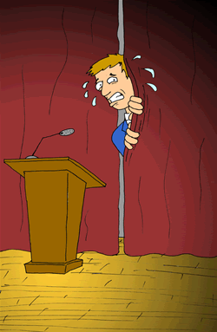

Slide 9
Gesture
The movement made by hands shoulders, head and torso
Gestures clarify ideas
Gestures influence the audience
Should be natural
Should not divert the attention of the listeners
Guard against the habitual awkward gestures
Notes:
It is the movement made by hands shoulder, head and torso. A well-timed gesture not only drives a points clear but also adds something to the presentation. Gestures clarify ideas and influence the audience. These should be natural and should not distract the audience.
gesture is the movement made by hands, arms, shoulders, head, etc .gestures clarify one’s ideas or reinforce them and should be well suited to the audience and occasion. Gestures should not divert the attention of the listeners. One’s gesture should be quite natural and spontaneous. Gestures are other non-verbal elements of communication. We try to convince our audience with a suggestive raising of hands; underline our denial with a shaking of head; express bewilderment with a movement of shoulders; and solicit urgent attention with a raised finger. These are natural accompaniments to speech. Right gestures in the right place make our presentation livelier. But to over-do them is undesirable. We have also got to guard against the habitual awkward gestures; like scratching of head, or playing with a pen or any other object.

Slide 10
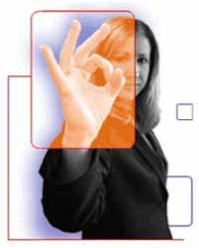

Slide 11
Facial Expressions
Eyes-- reflect truthfulness, intelligency, feelings and attitudes
Eyes - the key to the soul
Enhances rapport with the audience
Smiling face is the best introducer
Add to effect produced by the words
Notes:
Facial Expressions-- The eyes reflect the truthfulness, intelligence, feelings and attitudes of the speakers. The eye contact is a direct and powerful form of non verbal communication. Looking directly at the audience builds a rapport and keeps the audience attentive.
The audience watch your face. If you are looking listless or distracted then they will be listless and distracted; if you are smiling, they will be wondering why and listen to find out. In normal conversation your meaning is enhanced by facial reinforcement. Thus in a speech you must compensate both for stage nerves and for the distance between yourself and the audience. The message is quite simply: make sure that your facial expressions are natural, only more so.
The eyes are said to be the key to the soul and are therefore the first and most effective weapon in convincing the audience of your honesty, openness and confidence in the objectives of your presentation. This impression may of course be totally false, but here is how to convey it.

Slide 13
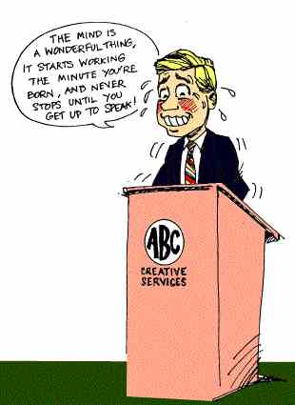

Slide 14
Proxemics
Edward Hall defined proxemics in the 1950’s and 1960’s
Space language is proxemics
Psychological power of the space must be used effectively.
Notes:
One of the terms used in non-verbal language is proxemics. Edward Hall defined proxemics in the 1950’s and 1960’s when he investigated man’s use of personal space in contrast with fixed and semi-fixed feature space. Fixed feature is what it is fixed has in unmovable boundaries. Semi-fixed is fixed boundaries that can be moved like furniture.
Proxemics can be divided in two other ways, physical and personal territory. Physical territory is like desks that are in front of the room of a classroom instead of center

Slide 15
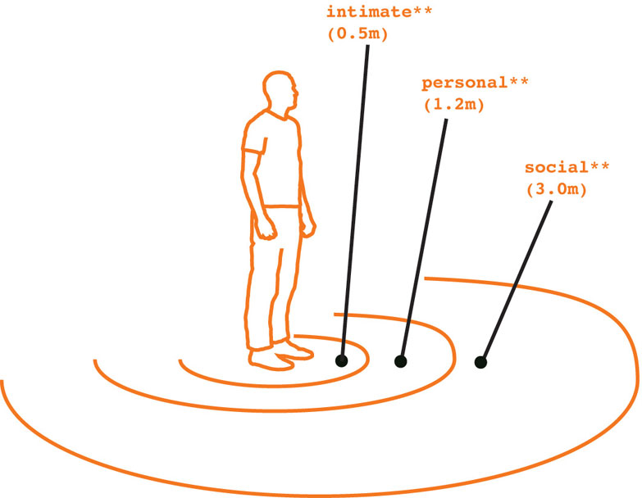

Slide 16
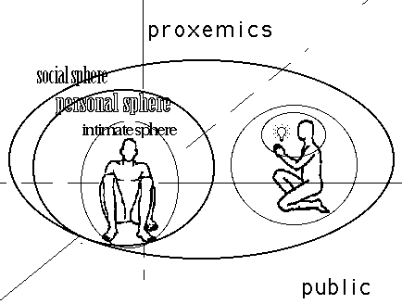

Slide 17
Types of space language
Intimate space language-
Personal touch extends to 18 inches,
intimate relationship
Members of the family, lovers, spouses, relatives and parents come in this circle. Only family members, relatives and friends enter this area.

Slide 18
Personal space language
From 18” to 4 feet
Casual and quite a relaxed space
Close friends, colleagues, peers etc.
Notes:
Personal space language—This zone stretches from 18” to 4 feet. Close friends, colleagues, peers etc. fall in this category. IWhere the speaker and the listener are in the personal space from 18inch to 48inchs come in the category of personal space language. In this circle they can have normal conversation. It is quite a relaxed and casual place. Sitting and standing so closed brings you closer to the listener and gives the impression of friendliness.
t is casual and quite a relaxed space

Slide 19
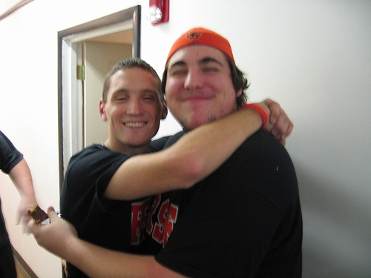

Slide 20
Social space language
From 4 feet to 12 feet
Relationships are official and formal
For formal purpose
Most of the businesses take place within this area.
Notes:
Social space language—Social events take place from 4 feet to 12 inches. The relationships are official and formal.

Slide 21
Public space language
From 12 feet to 30 feet
Shows formal relationship
Speaker has to raise his voice
Notes:
This spaces starts from 12 feet to 30 feet. This shows formal relationship. . Here the speaker has to raise his voice to communicate to others.
In the public space language the circle extends from 12 feet, as far as speaker is listened and seen. The events take place in this circle is formal.

Slide 22
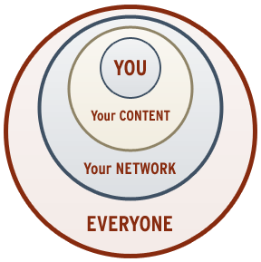

Slide 23
OBJECTIVE QUESTIONS & REFERENCES
Q 1. The role of the others part of the body than vocal is called:
A- kinesics
Q2. The space between two persons engaged in communication is called:
A- proxemics
Q3. What is kinesics?
A- science of body
Q4- What is the role of posture for presentation?
A - Standing, sitting, walking
Q5- what is considered to be the windows of the soul and heart?
A-Eye contact
Q.6 Face is the index of :
A. heart
Q.7.Eyes are considered -------of the soul.
A. windows
References:
1. Raman& Sharma: ‘Technical communication’, Oxford University press, New Delhi, India(2004)
2. Sharma & Mohan: ‘Business correspondence’ ,Tata McGraw-hill Publication company Limited, New Delhi(2006)

